Slide 1
Using the Five Practices in Afterschool Programming
Kymberley E. Pelky
Nicolet Federated Library System

Slide 2
The Five Practices
Play, talk, write, read and sing are the five practices of early literacy.
We gear these practices toward early literacy programming, but literacy is part of lifelong learning.
Notes:
(Read slide) Some of these practices are not being used as frequently in school, especially play, talk, and sing. While researching for this presentation, I was surprised to find I could add “write” to the list of practices not being used frequently in school! We will discuss using these practices as part of afterschool programming, using them to continue and enhance the literacy and learning.
These five practices are researched. They are proven to be effective ways to prepare early learners for school, but I didn’t see how these practices would be any less valuable for the school aged program attendees, whether it’s for afterschool, weekend, or even summer programming, and wanted to continue the learning this way, so that it is learning disguised, because it is learning that is fun!
Some of these ideas will take you right into teen programming.

Slide 3
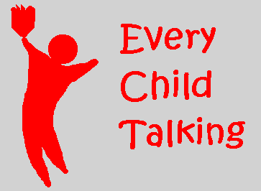
Get to know them
Open up dialogue: book, school, life…
Use books as the basis for conversation as needed, but don’t stop there!
Notes:
If you know the children for whom you conduct programming, this one is easy. If you don’t, it is a great way to connect with them, which will provide the basis for adding the other practices to everything you do with youth after school.
Ideas for talking include what some refer to as “book talk” or “shelf talk.” I do mean a book or shelf talk, where you can read a chapter of a great book instead of using a picture book, so the older youth feel your choice is more age appropriate, and then suggest similar books to read. Or find a shelf browser when you’re not programming and talk, too. Bunches of book talks for ideas (adapt for your program): http://teacher.scholastic.com/products/tradebooks/booktalks.htm
Keep in mind when you read chapter books, do it the same way you do the picture books to your early literacy crowd: wonder aloud, ask questions and have them predict what comes next. What is fun with the after school crowd is that you can also have them make alternate endings for the books or chapters!
Talk during a craft time, talk in the shelves. So many times I find all I have to do is get the conversation started and then it doesn’t stop. It’s not like the goal has to be getting them to talk to you—it can also be getting them to talk to each other, and in a polite, indoor voice, respectful kind of way!
In the bibliography is a link to a rubric for 6th and 7th graders in conducting a book talk as an assignment, but I thought some of the ideas given to them for their book talks could give you ideas for your own.

Slide 4
Singing: Probably the scariest of the practices, so let’s start off by changing this idea to “Music”…
Notes:
It’s easier for the singing to become a concept of “music” here. If you and your program attendees are comfortable with singing, go for it! Using language with the other side of your brain is a wonderful way to increase language comprehension, and having music as part of your programming is going to improve rhythmic thinking and comprehension, although studies actually show more improvement with math understanding.
Singing current song lyrics, tying in a current hit with a book on the shelf, developing a soundtrack for a character in a book you’re going to read or excerpt are all wonderful ways to get music and singing into your afterschool programs. Programs to use for multimedia use are Spotify, Pandora, or Grooveshark. Grooveshark, I know for sure, is one where you can make your own playlists based on the songs others have uploaded. If the idea of copyright has you nervous, look for music in Creative Commons.

Slide 5
It’s what we do. We also need to think about how we do it.
Notes:
Just as picture books have that “rich language” for the early learners, the chapter books offer language and vocabulary many children don’t hear in day-to-day life. Offering non-fiction selections to go along with a chapter book on display or being excerpted in a program is an even richer way to get their language synapses firing! I still use phonics ideas, or phonological awareness when I read, as I find the school age children still need this presented to them from time to time, interrupting the story to talk about the words’ sounds in a fun way, talk about rhyming, or even reading the word wrong—such as if it starts with a “g” I pronounce it with the wrong sound, like giraffe becomes Gur-affe instead, so they have to correct me. I slow it down a little to bring their attention to it. Sometimes I get everyone focused on the story again, too, once someone notices I said it wrong (if no one notices, I may bring it up and ask them about it, or I may keep going and pretend it never happened.)
For ideas on meeting the needs of my after school youth, I head to a page of standards, so I know what is expected of them. It’s the Common Core State Standards Initiative Page, and is listed in the Bibliography page. I usually gear my programs to the second and third grade level, unless it is specifically a teen/tween program, but it might be totally different for you. One of the schools in the area is considered an at-risk school and the children aren’t always age appropriate with their learning, but whether or not that pertains to the children in the program, I find meeting the needs a grade or even two below the age of the attendees makes it more fun. It’s review of those skills, and solidifies their foundation of learning without making it WORK, or challenging, which is what I don’t want in a general program. I’ve had swings in the population where that is what participants wanted, and would offer them something extra, but otherwise, no. Just fun and a review of skills they should already know.
Great picture books for younger school age are found at the Growing Wisconsin Reader School page, which is on the Resources slide, as is the Books by Theme page from Reading Rockets.

Slide 6
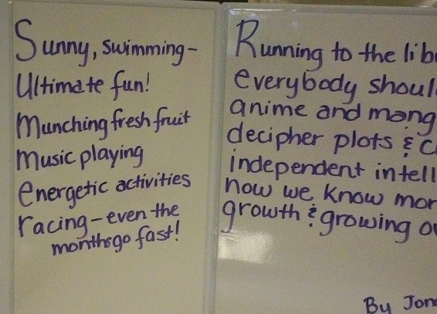
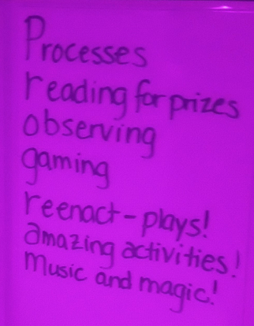
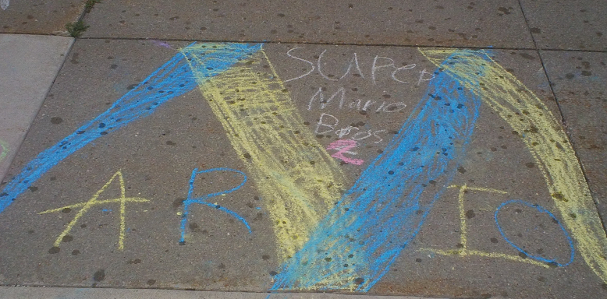
Utensil Use & Poetry
Notes:
For my early learning programs, I call writing Utensil Use. I keep that in mind for afterschool, too.
So much of more of children’s writing is now on the computer, but they still do write out assignments, and children still struggle with it. Incorporating chalk drawing outside, or painting with paintbrushes, gets them used to that grip without getting the groans that occur when I tell them we’re going to be writing during summer program or after school programs. I try to avoid the groans…
When it comes to actual writing, we do exercises that include writing. This summer I received a box of books from First Book called Disney’s Phineas and Ferb: Agent P’s Guide to Fighting Evil, and we went through the book for the summer reading program so we could all better learn to be heroes, each child getting to keep their copy. The book incorporated reading, writing, playing, and talking and I know some of the children came to the program just to work in the book some days. I will be hard pressed to come up with something else to do the same, but I am hoping to develop something with the sport theme because it was so successful. It was the book that actually made me think of the five practices being a part of the school aged programs we offer, although it wasn’t until we started the book and the summer program was in full gear, so I didn’t find a way to get singing in there except for the one day I made them sing a phrase of a song to be the passcode for entering their secret lair. Back to writing, however, and seeing that they needed this, and how it helped them understand more of what they were reading in the book when we reviewed, yet was fun enough that they didn’t see it as school work made me want to replicate what we were doing and implement something like it every summer.
I always incorporate journaling for the summer, but do not have many takers. I instead started developing “Playlists” for the participants. We take a part of the program and get everyone’s favorites, and they usually write them down, sometimes sharing why they like it. I then compile them and share them with the group, one year I even had them listed in the local paper. We do sometimes have questions that they write answers to for certain books or ideas presented, not only the favorites, but also topics like bullying. I have them write ideas down, then present them anonymously, putting the papers into a book or folder so they can’t see whose work I’m sharing.
I also incorporate poetry. I have some photos with some simple ideas we accomplished. I just happened to take the picture of the chalk drawing because it started to rain!
I found great writing ideas here, too: http://www.readingrockets.org/article/extending-interactive-writing-grades-2-5

Slide 7
Play is the work of children…Child Development Institute
Notes:
I am glad this slide is last because I’m hoping I can time this well enough to stretch it out if need be, although as talkative as I am, it’s much more likely I’ll need to cut it short. Which would be sad, as I’m an avid proponent of play!
Children’s time to play in schools has been greatly reduced! A study in 2008 by David Elkind showed that children have lost 20 hours of free play PER WEEK in the last 20 years. We can’t make it all up at the library, but we can help them provide some of that free choice play with our Drop-In Activities, and even some of our Offerings.
Here’s my second quote: “Research shows that children who engage in complex forms of socio-dramatic play have greater language skills than nonplayers, better social skills, more empathy, more imagination, and more of the subtle capacity to know what others mean. They are less aggressive and show more self-control and higher levels of thinking.” This was from an online article about the Crisis in Kindergarten and the importance of play, even though more and more it’s being taken away from children of all grades.
The studies on the importance of play are amazing in their findings! An article I found in Infosoup appropriately called, Play in the Library, quotes so many studies about it, and so I’ll be studying their references for awhile, but also says, “Perhaps the single best place…for learning through play is the library…it is a space that house the tools needed for knowledge building, and that play is a way for children to make sense of the world they will inherit. When information becomes something to play with, they have a way to cope with the vast amount available.”
So many libraries are offering Lego play times and other programs, and so this might be easy for you to incorporate by following their examples. My method is pulling out the puppet stage and providing puppets with a corresponding book. I’ve also scripted some of the animal fables like Tortoise and the Hare, Three Billy Goats Gruff, and the like so that the children can play with them, but then usually ad lib for the rest of the time they’re at the theatre, as their creative juices get flowing. I tried to insert the scripts as objects into the presentation, but it didn’t work. I plan on uploading this onto my LinkedIn account, and will put the scripts there, too, in case anyone wants to try them out with some puppets on their own. We also have board, card, and video gaming.

Slide 8
Bibliography -Italics mine…
Child Development Institute. Types of Play. http://childdevelopmentinfo.com/child-development/play-work-of-children/pl1/
Common Core State Standards Initiative. (2015.) English Language Standards…Literature…Grade Two http://www.corestandards.org/ELA-Literacy/RL/2/ But please, investigate the other pages for more ideas for the grades you focus on, and how to use non-fiction!
Common Core State Standards Initiative. (2015.) English Language Standards…Speaking & Listening (Talking!) …K http://www.corestandards.org/ELA-Literacy/SL/K/
Common Core State Standards Initiative. (2015.) English Language Standards…Writing…Grade One http://www.corestandards.org/ELA-Literacy/W/1/ Anything higher than Grade 2 is just WORK. I want it fun!
Encyclopedia of Play Science. http://www.scholarpedia.org/article/Encyclopedia:Play_Science
Keane, N. Book Talk Tips. http://nancykeane.com/booktalks/tips.htm
Miller, E. and Almon, J. Summary of…Crisis in Kindergarten. (The Need for Play!) http://www.nj.gov/education/ece/k/mod1/Crisis.pdf
National Institute of Play. Patterns of Play. http://www.nifplay.org/science/pattern-play/
Roth, K. Extending Interactive Writing. http://www.readingrockets.org/article/extending-interactive-writing-grades-2-5
Scholastic. Book Talks and Discussion Guides. http://teacher.scholastic.com/products/tradebooks/booktalks.htm
Silverioarsitio. Book Talk Assignment and Rubric. http://www.slideshare.net/silverioarsitio/book-talk-assignment-and-rubric
Walker, S. Take on Booktalks. http://www.slideshare.net/isl_pdo/take-on-booktalks?related=1
Wisconsin Department of Public Instruction. School Age. http://growingwisconsinreaders.org/school
The five practices and Ideas for the presentation graphics are from Every Child Ready to Read: http://www.everychildreadytoread.org/

Slide 9
Resources
Resources for garnering creative ways to incorporate the five practices (don’t just look at librarian resources, look for teacher and parent ideas, too!)
http://www.colorincolorado.org/
http://www.readingrockets.org/
For reading: http://www.readingrockets.org/books/booksbytheme
For writing: http://www.readingrockets.org/article/extending-interactive-writing-grades-2-5
For Singing: http://www.readingrockets.org/content/pdfs/literacybags/music_08.pdf
http://www.startwithabook.org/
For Singing: http://www.startwithabook.org/booklists/music-and-musicians#1
http://growingwisconsinreaders.org/school
Crow, S. and Robins, J. “Play in the Library.” Teacher Librarian. June 2012, Volume 39, Issue 5, pages 36-43 (found in Infosoup/Ebsco database)
https://search.creativecommons.org/ Music Search in Creative Commons (ccMixter and Jamendo are your choices for music searching)

